Slide 1
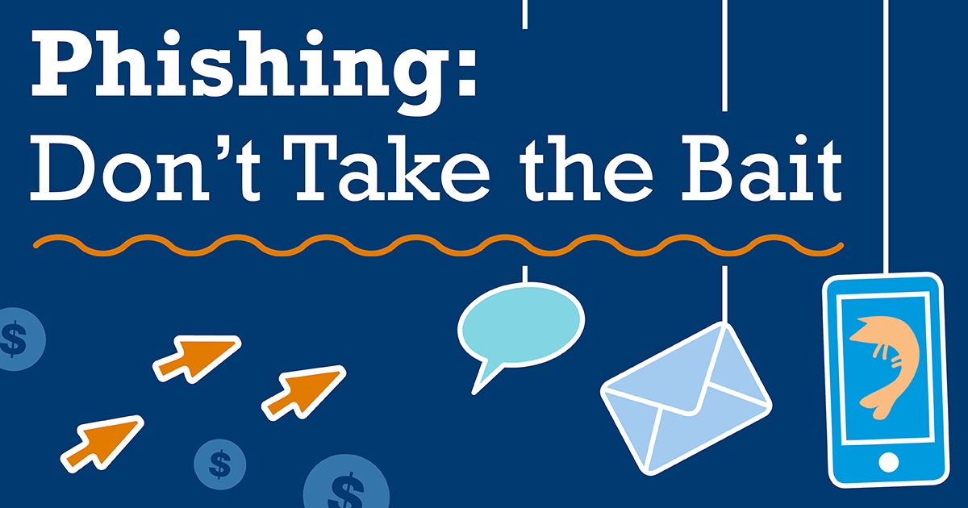
~ Arshiya Khan

Slide 2





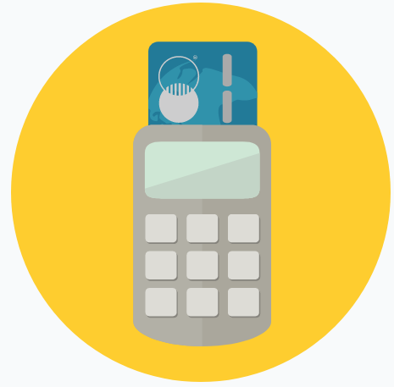

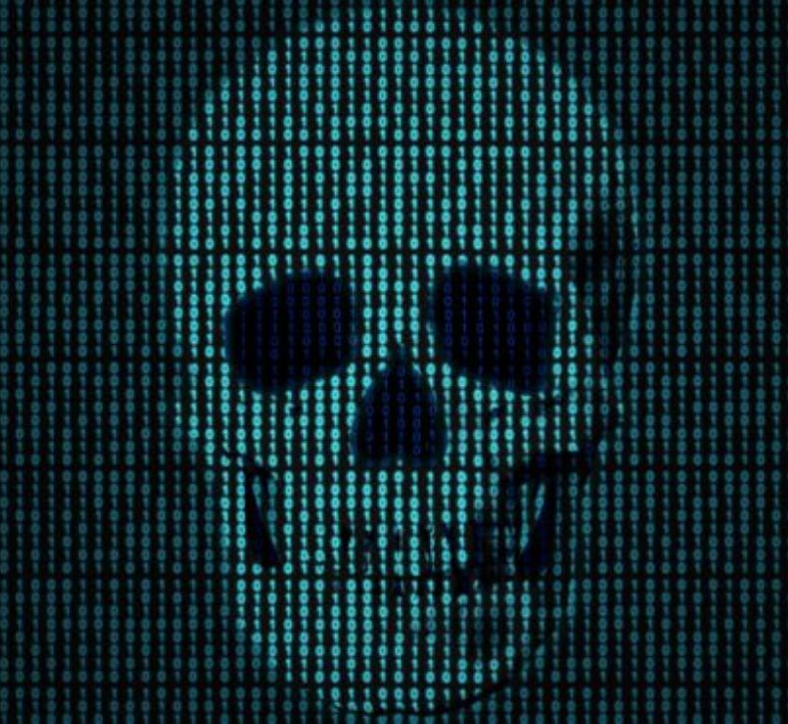
Target Breach! (Nov-Dec 2013)
What
HOW
aftermath
70,000,000 Personally Identifiable Information(PII)
Social security
Email address, phone
DoB, Address
Financial info
40,000,000 Credit/Debit Info
11 GB data
CEO, CIO, CSO sacked
$200 mil returned to customers by banks
140+ lawsuits filed
~$1B total damage
Fazio Mechanical Services, Pa

Slide 3
What is phishing
Social Engineering technique
The collection of personal data carried out illegally or fraudulently through the internet
Use the information collected to make purchases online, bank transfers or cash withdrawals on behalf of the fraud victim
UDel: reportaphish@udel.edu
US: phishing-report@us-cert.gov

Slide 4
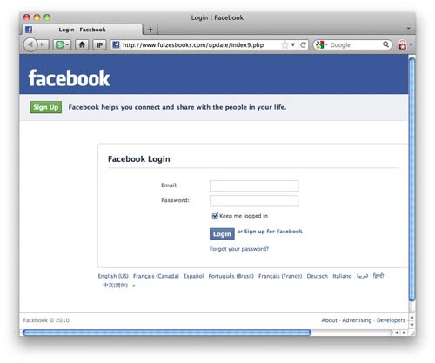
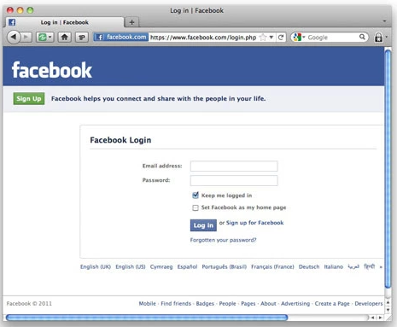
Detection

Slide 5
